Slide 1
CLC 2 Stacks and Queues
Ryan Coon
Allen Atkins
Carrie Assalone

Slide 2
Stacks

Slide 3
The class is based on the basic principle of last-in-first-out. In addition to the basic push and pop operations, the class provides three more functions of empty, search, and peek.

Slide 4
Stack<E> stack = new Stack(); - Creates a new stack
push() – This operation places the element at the top of the stack, along with adding new elements to the stack.
pop() – This operation “pops” the element from the top of the stack and is removes in the same manor.
empty() – This operation returns true if nothing is on the top of the stack, else it returns false.
peek() – This operation returns the element on the top of the stack but does not remove it.

Slide 5
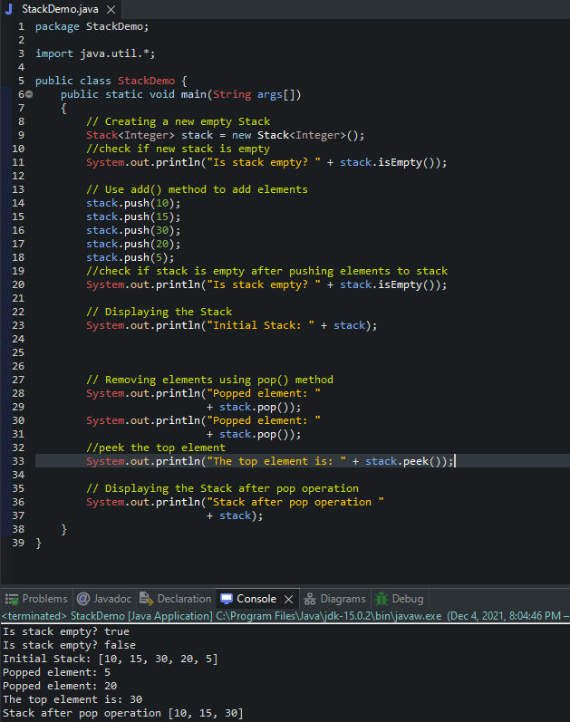
Time Complexity:
In stacks, The last element in a list is tracked
with a pointer called top. Popping an element
from a stack will take O(1) time complexity.
Popping the last element in a stack will
take O(n).

Slide 6
Queues

Slide 7
Elements are sorted by insertion order
First element in is first out (FIFO)
Elements have no index
Can only add to back and remove from front

Slide 8
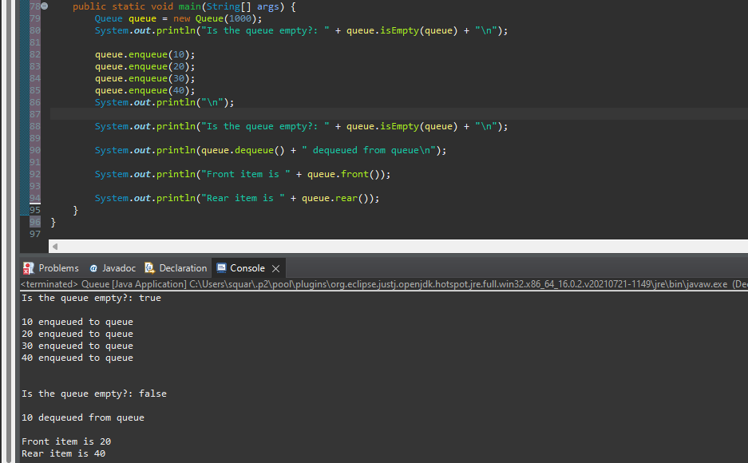
Time complexity
Enque O(1)
Deque O(1)
Front O(1)
Rear O(1)

Slide 9
References:
Stack class in Java. GeeksforGeeks. (2021, August 3). Retrieved December 4, 2021, from https://www.geeksforgeeks.org/stack-class-in-java/.

